Slide 1
SK1
Data Mapping Framework

Slide 2
Why?
Needs
Opportunity
Data access for all Agency staff
Singular centralized tool
Self Service of data
Simple but effective interface
Ability to ask questions of data
Repackage multiple data sources
Flexibility of GIS web services technology
Development of VTrans Data Hub
Organizational readiness

Slide 3
User Spectrum

Slide 4
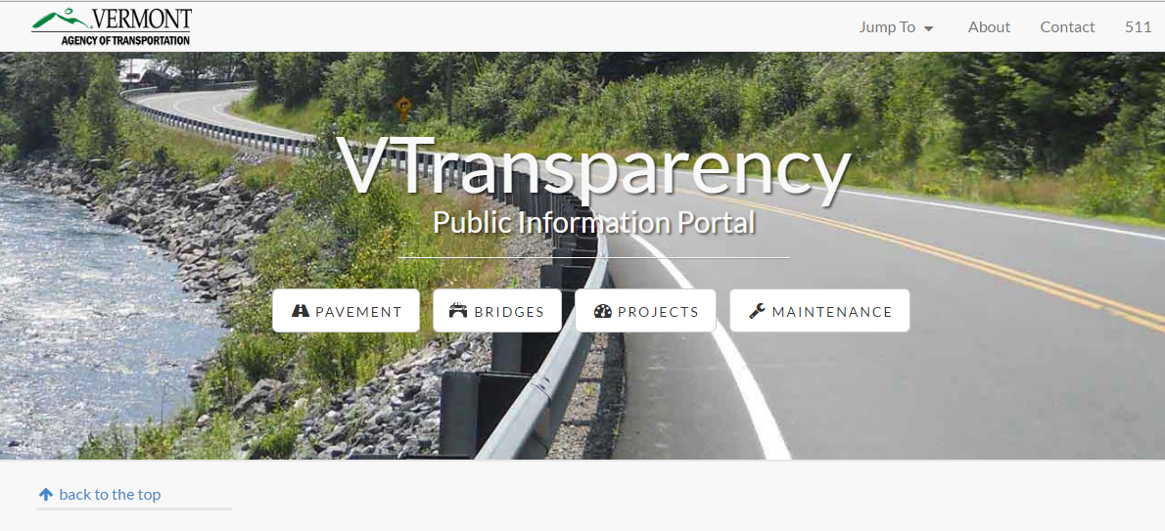
Centralized

Slide 5
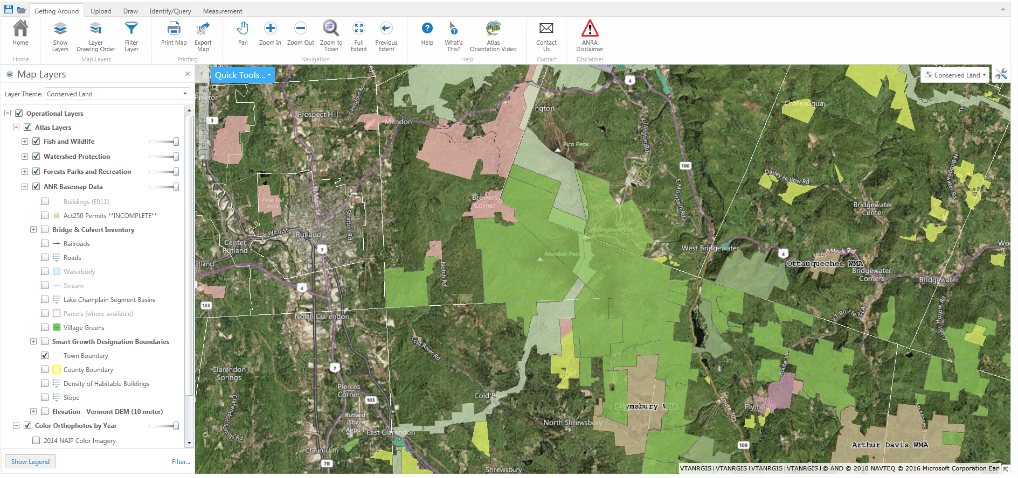
Simple & Effective

Slide 6
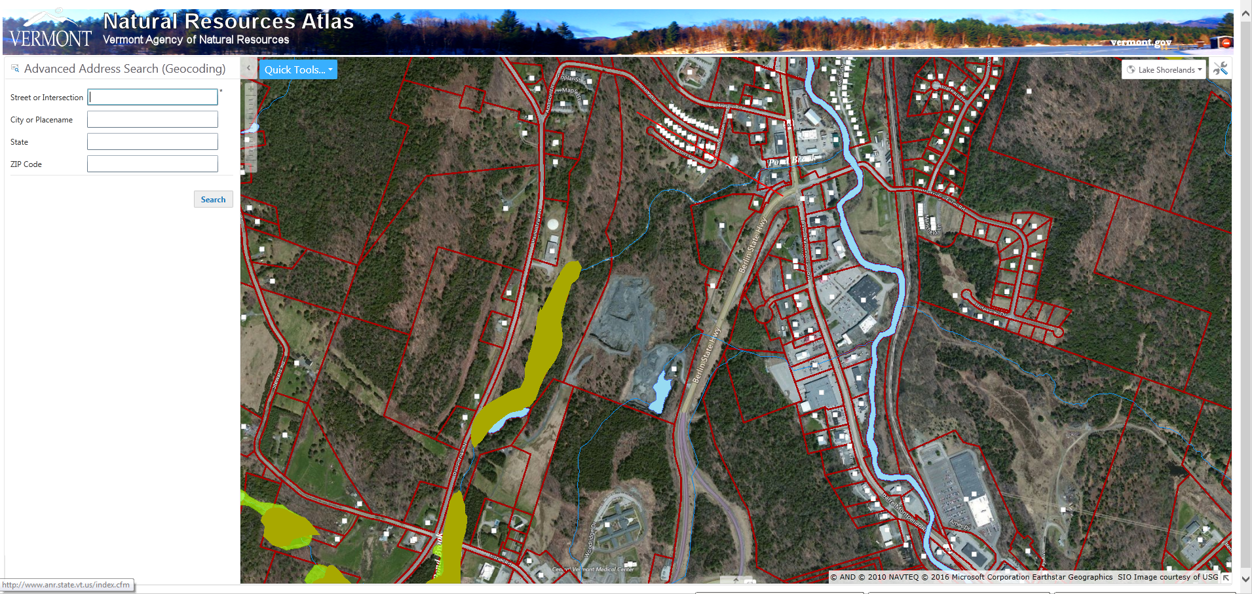
Interactive

Slide 7
Repackage Data

Slide 8
How?
Phase 1
Identify user groups and data requirements
Identify major analysis workflows
Phase 3
Implement vendor development
Phase 4
Identify additional user groups and data requirements
Mix in house and vendor development to enhance product
Develop project scope
Phase 2
Vendor training of VTrans Staff
Contract initial development
Begin in house development

Slide 9
Potential User Groups
Programming / Scoping
Maintenance Viewer
Asset Management

